Slide 1
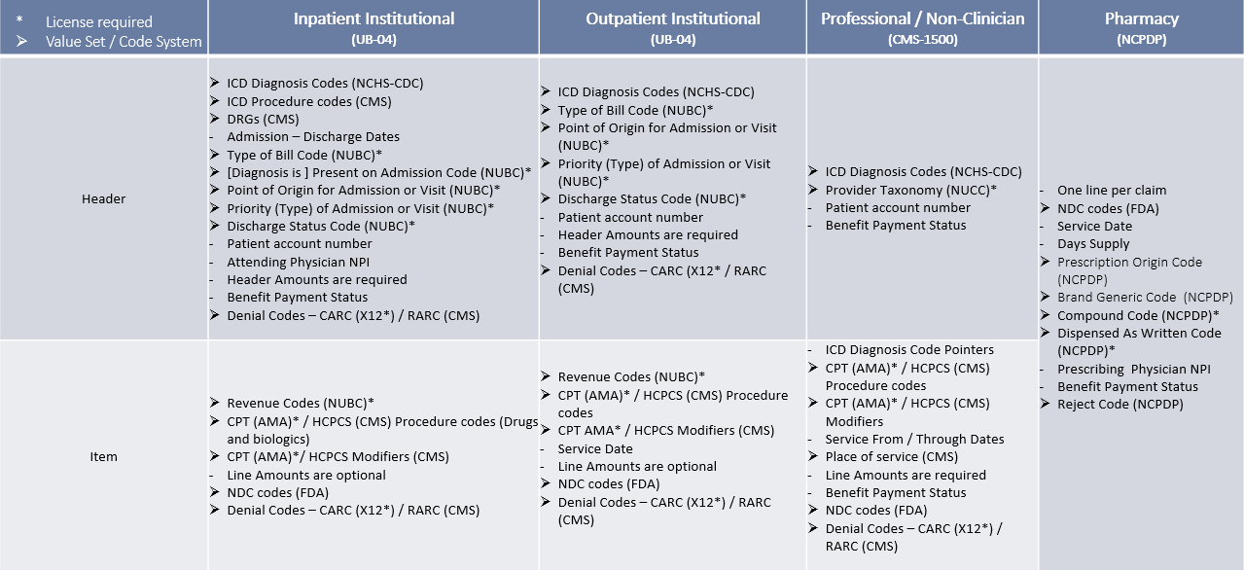
EOB| Profiles align with claims submission standards adopted by the Department of Health and Human Services. The result is multiple EOB Profiles:

